Slide 1
Seminar 3
2016/04/09 Tran viet cuong

Slide 2
In 2 weeks
DSP
Raspberry pi 2 and DSP

Slide 3
Dsp
The Scientist and Engineerr’s Guide to digital signal Processing by Smith
Statistic, Probability, Noise
Histogram, pmf, pdf
Precisions and Accuracy
ADC and DAC
The Sample Theorem
DSP software
Linear System
Common Decompositions FFT
Convolution and Properties
Discrete Fourier Transform

Slide 4
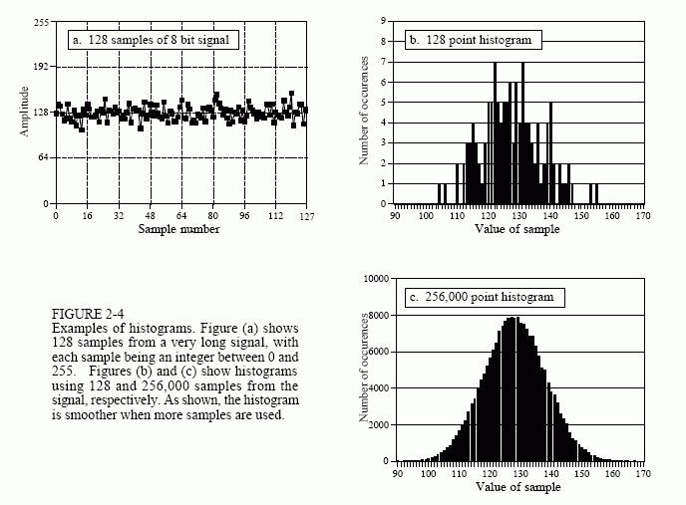
Dsp
Statistic, Probability, Noise
Histogram, pmf, pdf
Precisions and Accuracy
ADC and DAC
The Sample Theorem
DSP software
Linear System
Common Decompositions FFT
Convolution and Properties
Discrete Fourier Transform

Slide 5
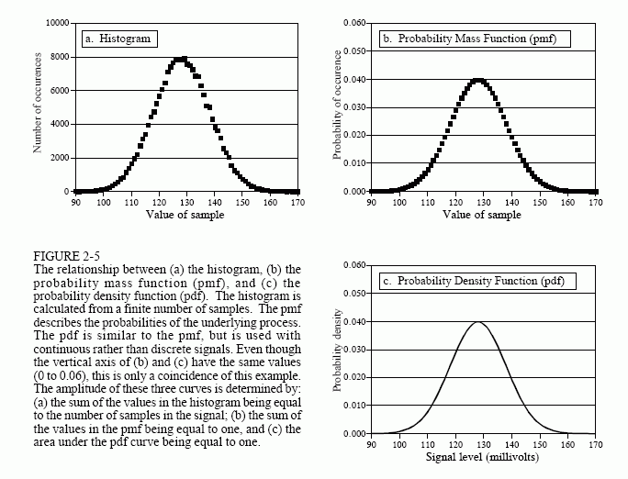
Dsp
Statistic, Probability, Noise
Histogram, pmf, pdf
Precisions and Accuracy
ADC and DAC
The Sample Theorem
DSP software
Linear System
Common Decompositions FFT
Convolution and Properties
Discrete Fourier Transform

Slide 6
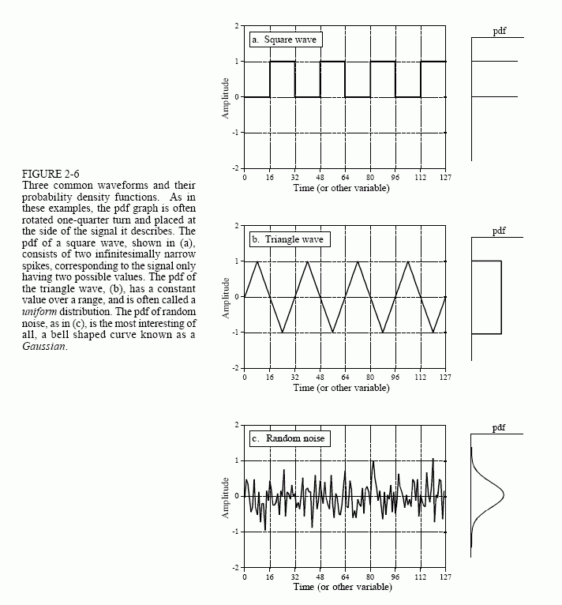
Dsp
Statistic, Probability, Noise
Histogram, pmf, pdf
Precisions and Accuracy
ADC and DAC
The Sample Theorem
DSP software
Linear System
Common Decompositions FFT
Convolution and Properties
Discrete Fourier Transform

Slide 7
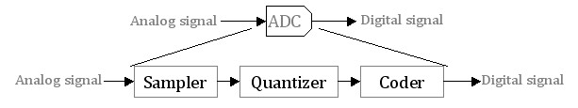
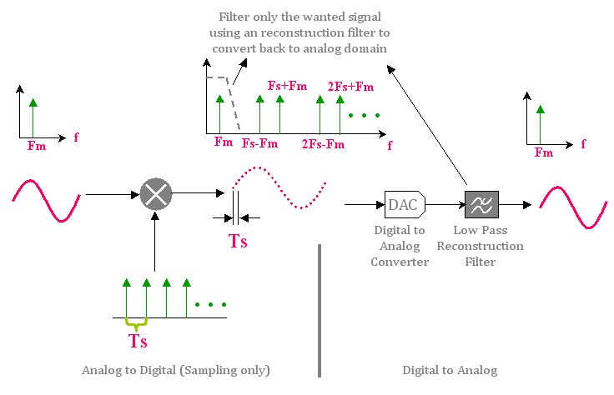
Dsp
Statistic, Probability, Noise
Histogram, pmf, pdf
Precisions and Accuracy
ADC and DAC
The Sample Theorem
DSP software
Linear System
Common Decompositions FFT
Convolution and Properties
Discrete Fourier Transform

Slide 8
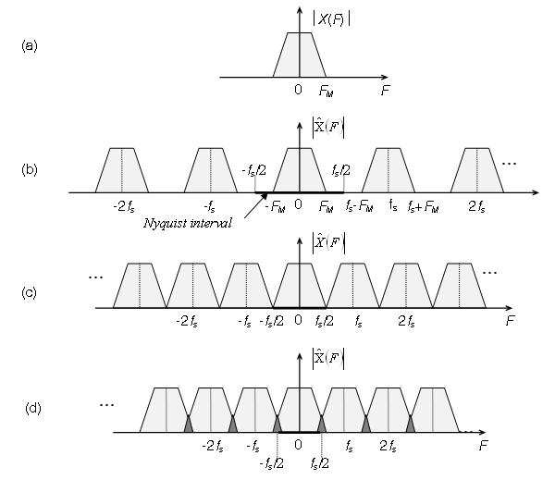
Dsp
Statistic, Probability, Noise
Histogram, pmf, pdf
Precisions and Accuracy
ADC and DAC
The Sample Theorem
DSP software
Linear System
Common Decompositions FFT
Convolution and Properties
Discrete Fourier Transform
Fs >= 2Fm

Slide 9
Dsp
Common Decompositions
Impulse Decomposition
Step Decomposition
Even/ odd Decomposition
Interlaced Decomposition
Fourier Decomposition
Statistic, Probability, Noise
Histogram, pmf, pdf
Precisions and Accuracy
ADC and DAC
The Sample Theorem
DSP software
Linear System
Common Decompositions FFT
Convolution and Properties
Discrete Fourier Transform

Slide 10
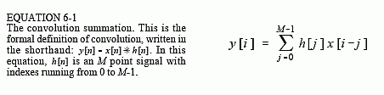
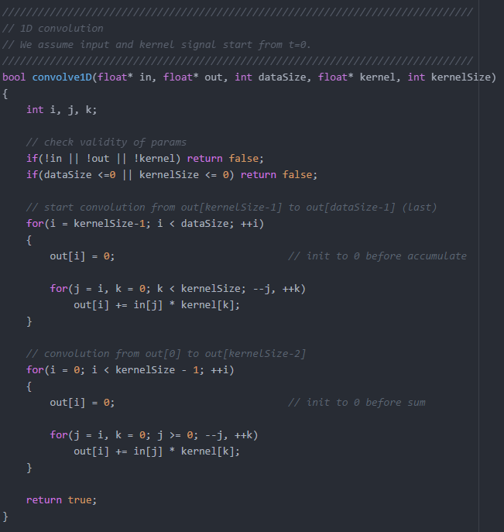
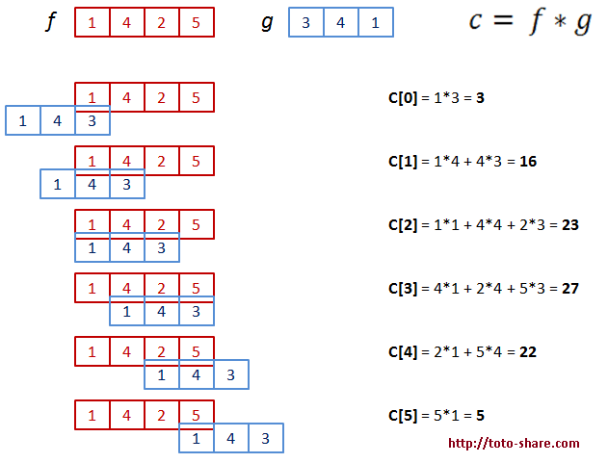
Dsp
Convolution is a mathematical way of computing two signals to form a third signal.
x[n]*h[n] = y[n]
Statistic, Probability, Noise
Histogram, pmf, pdf
Precisions and Accuracy
ADC and DAC
The Sample Theorem
DSP software
Linear System
Common Decompositions FFT
Convolution and Properties
Discrete Fourier Transform

Slide 11
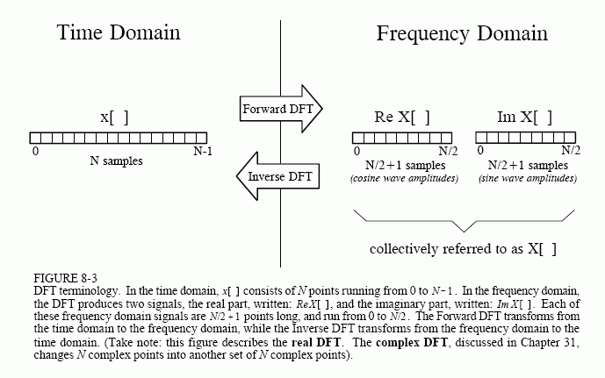
Dsp
Statistic, Probability, Noise
Histogram, pmf, pdf
Precisions and Accuracy
ADC and DAC
The Sample Theorem
DSP software
Linear System
Common Decompositions FFT
Convolution and Properties
Discrete Fourier Transform

Slide 12
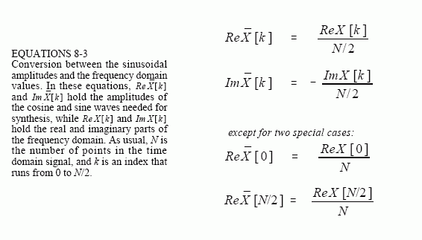
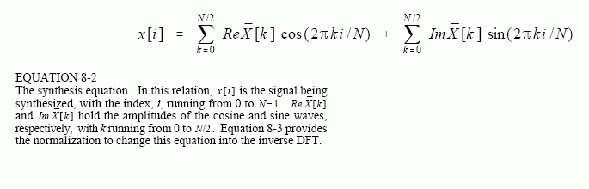
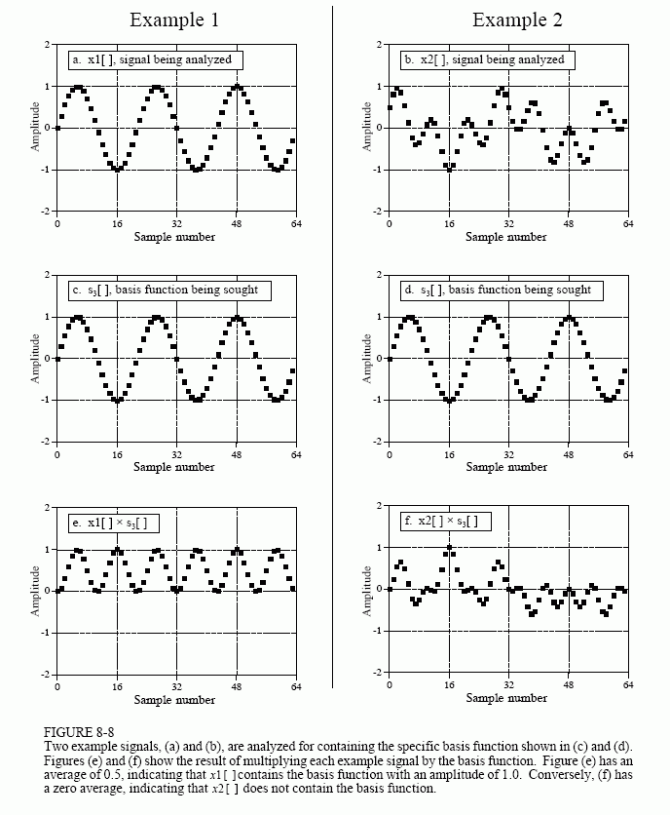
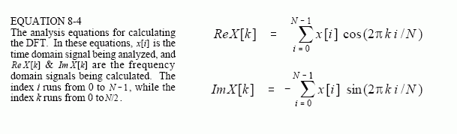
Dsp
Synthesis, Calculating the Inverse DFT
Statistic, Probability, Noise
Histogram, pmf, pdf
Precisions and Accuracy
ADC and DAC
The Sample Theorem
DSP software
Linear System
Common Decompositions FFT
Convolution and Properties
Discrete Fourier Transform
Analysis, Calculating the DFT

Slide 13
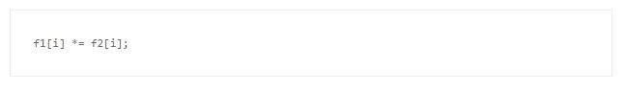
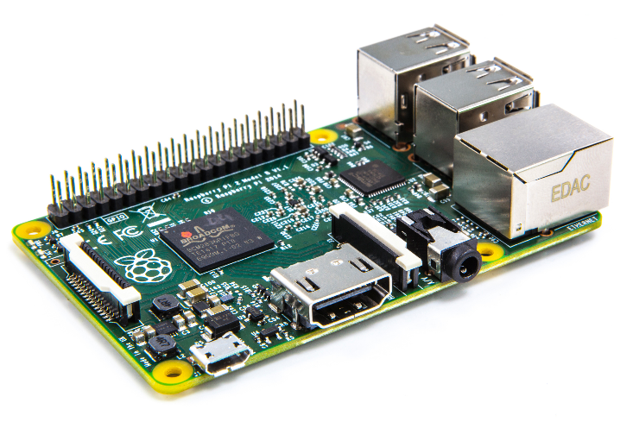
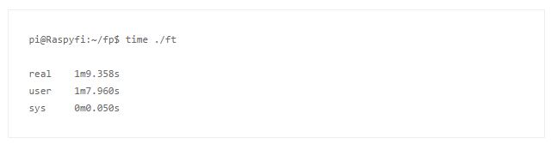
DSP on rasp pi 2
- Operating system
- CPU 900MHz, 1 GB
- Requires a 2Amp Power Supply

Slide 14
Next 2 weeks:
Fundamental DSP
Biomedical sensors and make digital filters on Rasp pi

Slide 15
Thank you!

